Slide 1
Car Price Prediction Using Machine Learning
Presented by : Adarsh Pandey
Jayesh Wagh
Sahil Goankar
B.E. (Computer Engineering)
PIN:ARMIET/CS20PA004
ARMIET/CS20WJ009
ARMIET/CS20GS006
Semester- VII
Guided By :

Slide 2
CONTENTS
Objective
Introduction
Abstract
Problem Statement
Problem Solution
Features
Literature Survey
Literature Table
System Architecture
Software Requirement
Use Case Diagram
Conclusion

Slide 3
Objective
To build a supervised machine learning model for forecasting value of a vehicle based on multiple attribute.
The system that is being built must be feature based i.e., feature wise prediction must be possible.
Providing graphical comparison to provide a better view.
.

Slide 4
INTRODUCTION
From a long time since being, a continuous paradigm of transactions of commodities has been into existence. Earlier these transactions were in the form of barter system which later was translated into a monetary system. And with consideration into these, all charges that were brought about the pattern of re-selling item was affected as well. There are two ways in which the re-selling of the item is carried out. One is offline and other being online.
In offline transactions, there is a mediator present in between who is very vulnerable to being corrupt and make overly profitable transactions. The second option is online wherein there is a certain platform which lets the user find the price he might get if he goes for selling.

Slide 5
Abstract
A car price prediction has been a high-interest research area, as it requires noticeable effort and knowledge of the field expert. Considerable number of distinct attributes are examined for the reliable and accurate prediction. To build a model for predicting the price of used cars in Bosnia and Herzegovina, we applied three machine learning techniques (Artificial Neural Network, Support Vector Machine and Random Forest). However, the mentioned technique were applied to work as an ensemble. The data used for the prediction was collected from the web portal autopijaca.ba using web scraper that was written in PHP programming language.

Slide 6
Problem statement
Dataset Features:
Car Brand
Year
Solid Price
Present Price
KMS Driven
Fuel Type
Seller Type
Transmission Type
Owners

Slide 7
Problem Solution
By the result above, here XGBoost Regressor gives more accuracy and next is Random Forest Regressor. Therefore, here I can conclude that for regression problem XGBoost and Random Forest Algorithms give more accurate results when compared to Linear, KNN and other Regression.
Pandas
In-build Function in python.

Slide 8
Features
Able to predict actual car cost according to the current market price.
Able to use the search data as an prior Dataset.
Provide a Graphical user interface.
It also provide an owner name and details about seller
Help you to sell your car on the recent on going price according to the car usage or age.

Slide 9
Literature Survey
The first paper is Predicting the price of Used Car Using Machine Learning Techniques.In this paper, they investigate the application of supervised machine learning techniques to predict the price of used cars in Mauritius. The predictions are based on historical data collected from daily newspapers. Different techniques like multiple linear regression analysis, k-nearest neighbours, naïve bayes and decision trees have been used to make the predictions.
The Second paper is Car Price Prediction Using Machine Learning Techniques. Considerable number of distinct attributes are examined for the reliable and accurate prediction. To build a model for predicting the price of used cars in Bosnia and Herzegovina, they have applied three machine learning techniques (Artificial Neural Network, Support Vector Machine and Random Forest).

Slide 10
LITERATURE Table
SR No. | AUTHOR NAME | Conclusion & Working | Journal
1. | Miloni M. Lina | Car price prediction has an ability to use dataset and predict future and current price | IJOSSN
2. | Dr. J.J lois, and Dr. K.l gorgio | Prediction of any price depend on many things and parameter such as multivalute. | IJOSSN

Slide 11
LITERATURE Table
SR No. | AUTHOR NAME | Conclusion & Working | Journal
3. | Chandramouli et al. (2021) | Car price prediction are method to solve many by direction values using regression analysis. | ICENCO

Slide 12
LITERATURE Table
Sr.No. | AUTHOR NAME | Conclusion & Working | Journal
3 | Kumar and Kumar (2021) | Students’ location is decided by GPS using phones. this is defined as a key to marking attendance [12]. | IRJET

Slide 13
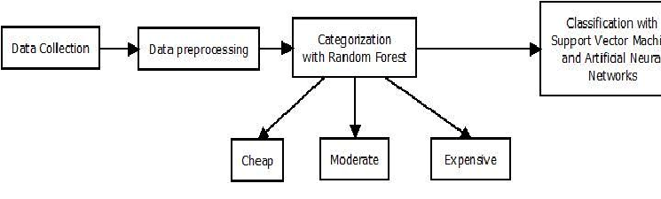
SYSTEM ARCHITECTURE
Fig:- Car Price Prediction

Slide 14
Software requirements:
Anaconda IDE Software
Jyupetur notebook
Pycharm Software
Pandas Libraries
Ex-cel Spreadsheet
Big Data Analytics
Machine Learning Package

Slide 15
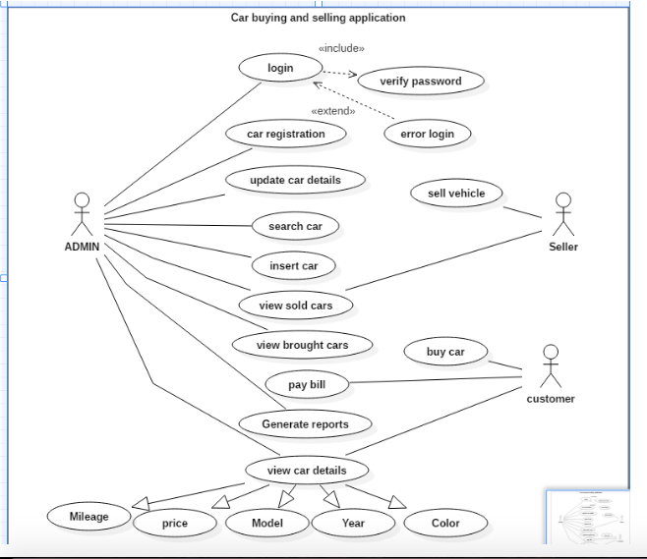
Use Case Diagram

Slide 16
CONCLUSION
Car price prediction can be a challenging task due to the high number of attributes that should be considered for the accurate prediction. The major step in the prediction process is collection and preprocessing of the data. In this research, PHP scripts were built to normalize, standardize and clean data to avoid unnecessary noise for machine learning algorithms.
Data cleaning is one of the processes that increases prediction performance, yet insufficient for the cases of complex data sets as the one in this research. Applying single machine algorithm on the data set accuracy was less than 50%.

Slide 17
REFERENCES
https://www.academia.edu/35975560/Regression _Based_Machine_Learning_Prediction
http://article.sciencepublishinggroup.com/pdf/10.11648.j.ijssn.20190704.11.pdf

Slide 18
Thank You

